Slide 1


Predicting Customer Churn : case of a telecommunication company
Idriss Dem
Course : MIS637

Slide 2
Introduction
It is a fact: the goal of a business is to generate benefits. Because it is important for companies to maximize their revenues and thusly gain and retain as many customers as possible, it is important to know what the patterns and aspects of services/products are making clients stay or go, and thus act accordingly to reduce the churn rate and give incentives for clients to stay.
Predicting churn could help act before the clients leave: companies could have a view of where they fail the clients and where they excel as well and therefore engage the appropriate changes. Indeed, being able to keep its customer base is safer than only focusing on attracting new clients. Why? The race to acquiring new customers has a lot of bumps and competition is fierce in all sectors nowadays. In this way, companies must deal with competitors and a high level of uncertainty. This is the reason why keeping the customer base is a strong factor of long-term success and thrive. As a matter of a fact, being able to retain current clients and attract more is an ideal situation.
Orienting this analysis towards the case of telecommunication company is an excellent way of applying customer churn prediction as well as gaining a thorough knowledge over the subject and everything it involves.
To perform the analysis, different methodologies and algorithms are to be used: clustering will be utilized in the exploratory data analysis phase to identify clusters of customers and better understand customer habits; to predict customer churn: decision trees (C4.5), logistic regression and Artificial Neuro Networks will be performed and the algorithm with the better result in terms of accuracy will be selected as the final model.

Slide 3
Standard Process: CRISP-DM
To understand the problem and solve it the right way, the CRISP-DM methodology is used.
The Cross Industry Standard Process for Data Mining (CRISP-DM) is composed of 6 phases :
1- Business Understanding
2- Data Understanding
3- Data Preparation
4- Modeling
5- Evaluation
6- Deployment
Business / Research Understanding Phase
Data Understanding Phase
Deployment Phase
Data Preparation Phase
Evaluation Phase
Modeling Phase

Slide 4
Business Understanding
What is the problem statement? Predict customer churn for the telecommunication company
Goal: making use of data mining techniques that are decision trees algorithms, logistic regression and artificial neural networks, to classify customers as churning or not, and afterwards derive rules.
Accomplishments? Thanks to the derived rules and most appropriate algorithm, the telecommunication company will be able to identify the customers(and their different characteristics, i.e., monthly charges paid, using additional services, etc….)churning and those who do not.
Therefore, the company could prevent customers leaving by coming up with appropriate changes prone to customer retention.

Slide 5
Data Understanding
Data Source : The dataset is very recent and has been collected on Kaggle. It has been compiled by the dataset owner who uploaded it on the platform. The upload data is 02/22/2021. The dataset reprises the customer database of a telecommunication company with, as one of its variable, whether the customer stayed or left.

Slide 6
Data Understanding
Details:
5976 records with 1587 churners and 4389 non churners.
There are 21 attributes, which 20 are independent and 1 is the target.
The t\arget attribute, ‘Churn’, classifies a client as churning or not.
18 attributes are categorical, either of type ‘yes’ or ‘no’, 0 or 1, or 3 choices describing the attribute. The target is categorical of type 0 or 1.
3 attributes are continuous variables.

Slide 7
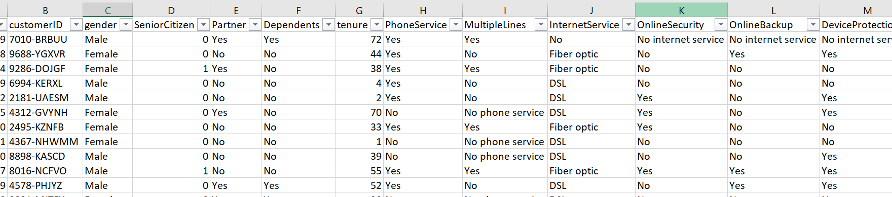
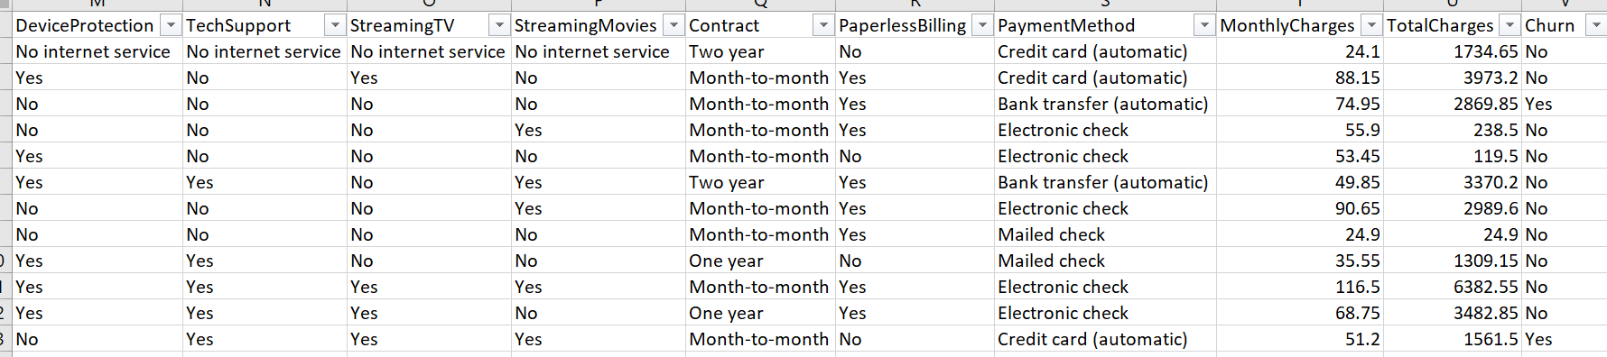
Data Understanding
Dataset Sample :

Slide 8
Data Understanding
Attribute details:
1- CustomerID : id of each customer continuous variable
2- gender: gender of the client (values : male, female)
categorical variable 3- SeniorCitizen: if the client is a senior citizen or not (values : 0,1) categorical variable
4- Partner: does the client have a partner or no (values: yes, no) categorical variable 5- Dependents: does the client have dependents or no (values: yes, no) categorical variable 6- tenure: for how long has the person been a client for the services provided by the company continuous variable
7- PhoneService : is the client using the phone service provided by the company (values : yes, no) categorical variable 8- MultipleLines: does the client have many lines with the company (values: yes, no, no phone)

Slide 9
Data Understanding
9- InternetService : is the client using the internet service provided by the company (values : DSL, fiber optic, no) categorical variable 10- OnlineSecurity : does the client use the online security service related to the internet service (values: yes, no, no internet service) categorical variable 11- OnlineBackup : did the client subscribe to the online backup service related to the internet service (values: yes, no, no internet service) categorical variable 12- DeviceProtection: did the client subscribe for internet material protection (values : yes, no, no internet service) categorical variable 13- TechSupport: did the client subscribe for internet tech support (values: yes, no, no internet service) categorical variable
14- StreamingTV: if the client subscribed to the tv streaming service (values: yes, no, no internet service) categorical variable

Slide 10
Data Understanding
15- StreamingMovies: if the client subscribed to the movies streaming service (values: yes, no, no internet) categorical variable
16- Contract: subscription contract duration (values: one year, two years, month to month) categorical variable
17- PaperlessBilling: if the bill is sent electronically (values: yes, no) categorical variable
18- PaymentMethod : method used to process billing payments (values: credit card, bank transfert, electronic check, mailed check) categorical variable
19- MonthlyCharges: amount paid monthly for all subscribed services continuous variable
20- TotalCharges: total amount paid by client regarding tenure continuous variable
21- Churn : If the client stayed with the company or left (values: yes, no) categorical variable

Slide 11
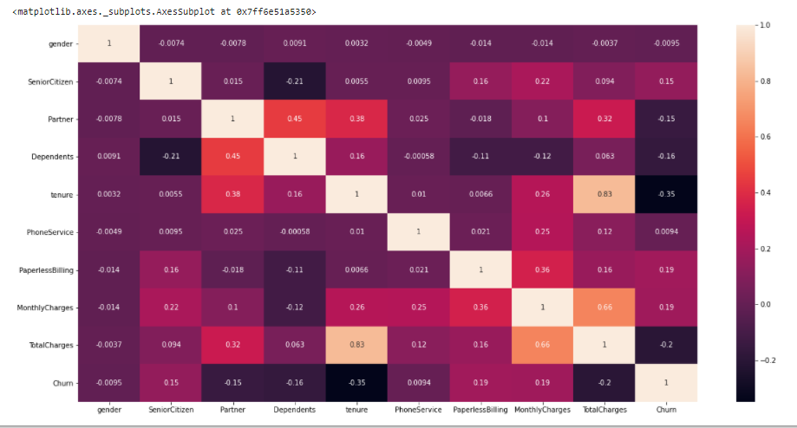
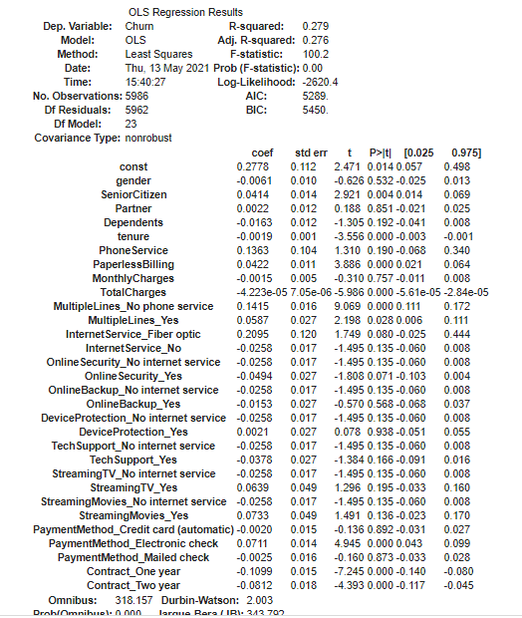
Data Understanding
Conducted Ordinary Least Square method to compare results with heatmap regarding variables importance
Heatmap to see importance of variables

Slide 12

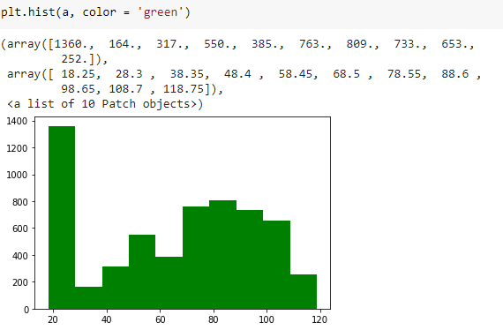
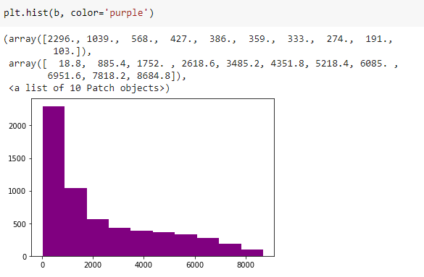
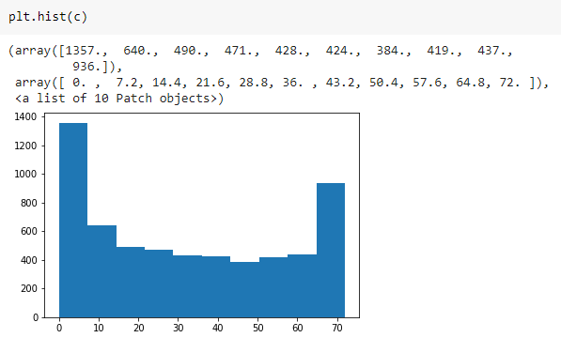
Data Understanding
Checking continuous variables distribution :

Slide 13
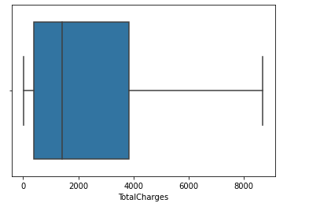
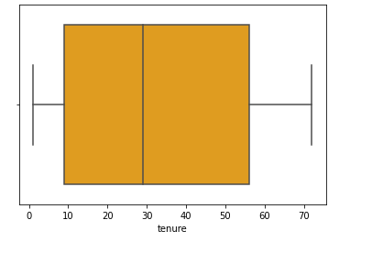
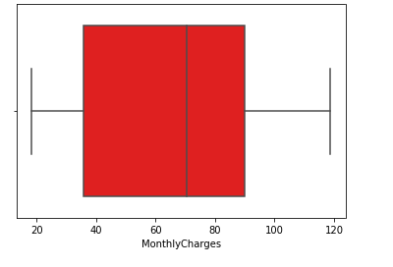
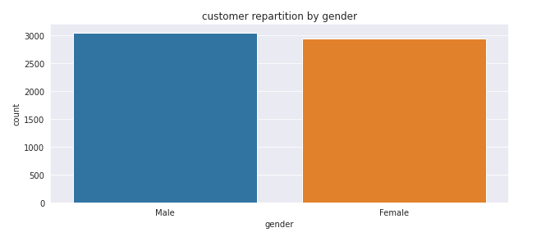
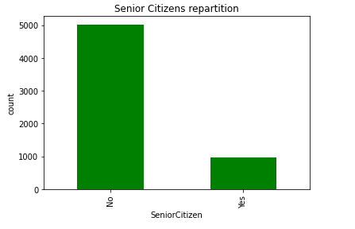
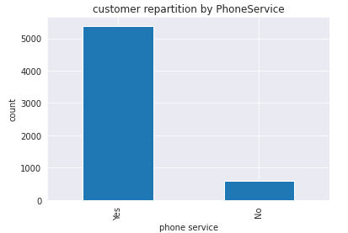
Data Understanding
No apparent existence of outliers for continuous variables
Analyzing some variables repartition

Slide 14
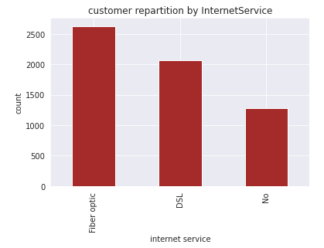
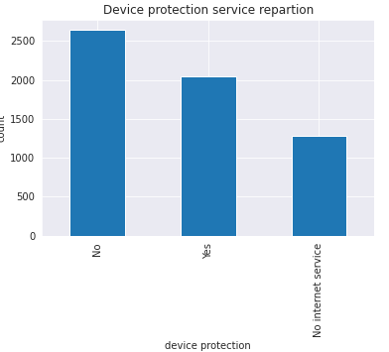
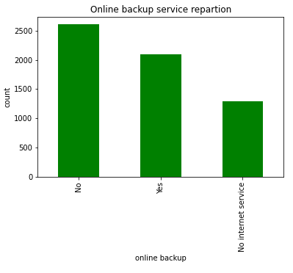
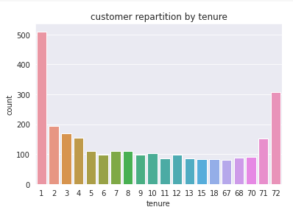
Data Understanding
Analyzing some variables repartition

Slide 15
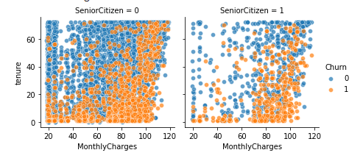
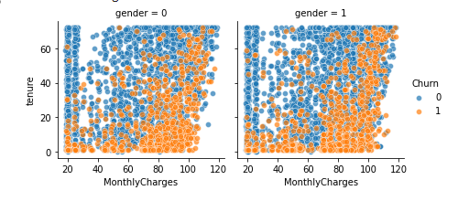
Data Understanding
As monthly charges increase, the churn rate is higher. Long tenures seem to favor staying with the operator. Shorter tenures tend to influence customer churn.

Slide 16
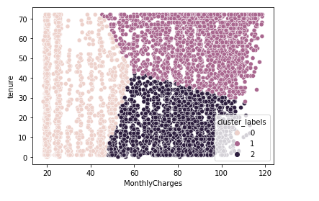
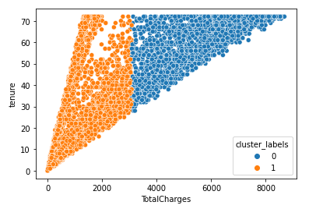
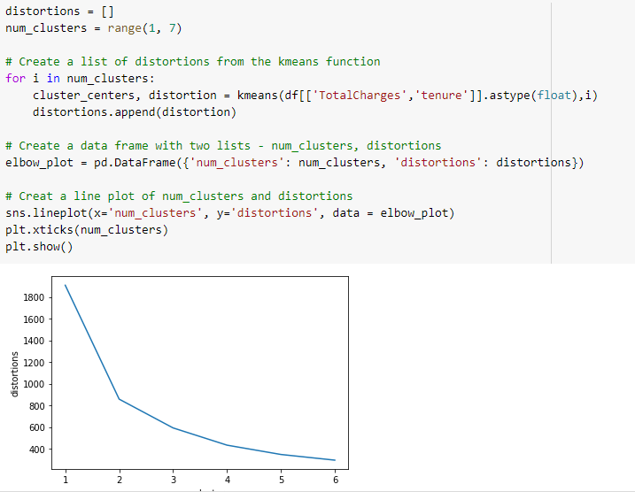
Data Understanding
Cluster analysis to potentially identify patterns
3 clusters identified for monthly charges vs tenure
2 clusters identified for monthly charges vs tenure
Definition of function to find optimal number of clusters for concerned variables (lower left side).

Slide 17
Data Understanding
Exploratory Data Analysis : this study permits to familiarize with the dataset and eventually discover initial insights
Selection of variables for model application :
The relevant variables for predicting churn are ‘SeniorCitizen’, ‘Partner’, ‘Dependents’, ‘tenure’, ‘PaperlessBilling’, ‘MonthlyCharges’, ‘TotalCharges’.

Slide 18
Data Preparation
In order to run the different algorithms, the dataset needs to be cleansed and transformed
The following aspects are thoroughly reviewed in the dataset: - handling missing data - identifying misclassification - identifying outliers - transforming variables that needs to be - normalizing data if needs to be

Slide 19
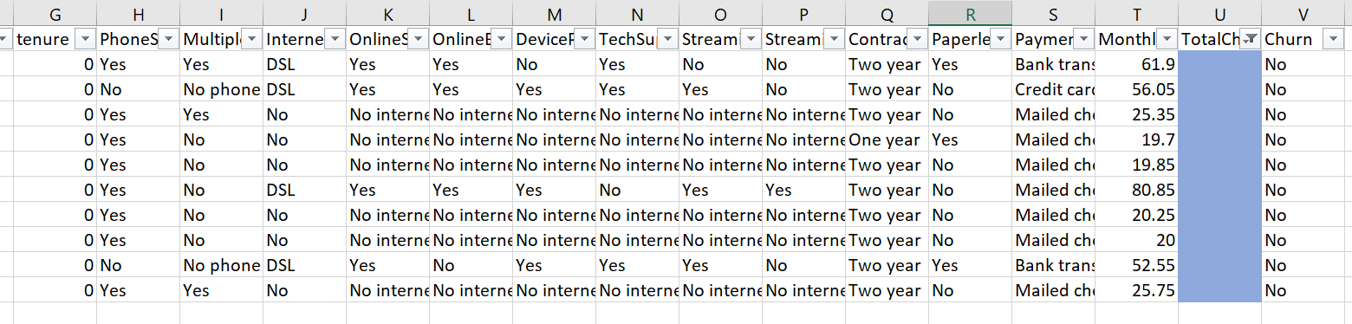
Data Preparation
Handling missing data:
The dataset has 10 missing values for the attribute “TotalCharges”.
Because this attribute is mainly the result of a multiplication between attribute “tenure” and attribute “MonthlyCharges”, the missing values were filled accordingly.

Slide 20
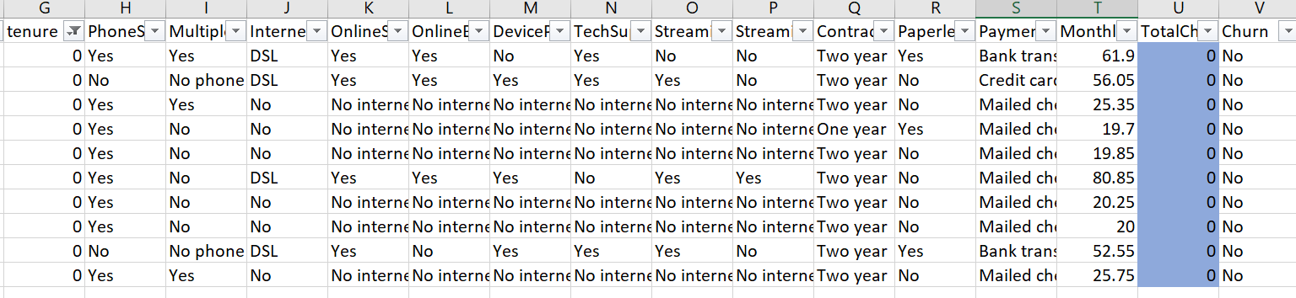
Data Preparation
Thus, the dataset is filled with the new computed values as follows:
This result is not surprising as the “tenure” for all the missing values in “TotalCharges” is 0, meaning that the customer is new and have not been client for 1 month yet.

Slide 21
Data Preparation
Identifying misclassifications:
No misclassifications found
Identifying outliers: No outliers were found (graphically shown via EDA)
Transforming variables and normalizing data : Through the software Python, the dataset is scaled and standardized before training an algorithm on the latter. Thus, great variability is well handled. The StandardScaler command from scikit learn used on Python follows the formula :

Slide 22
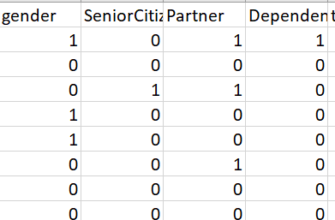
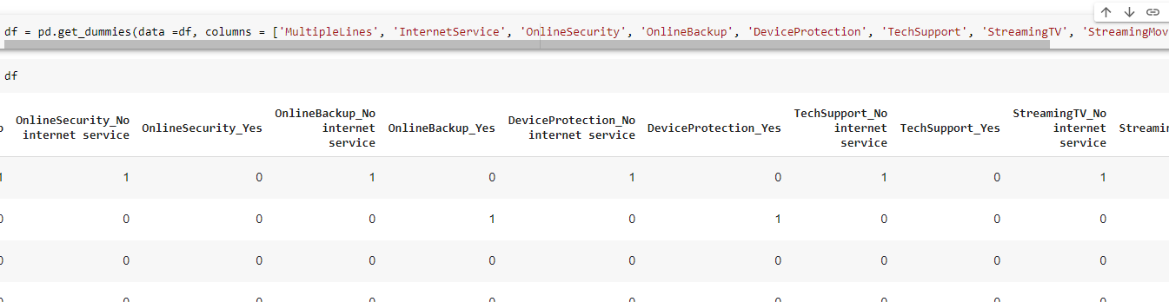
Data Preparation
Categorical variables with values : yes, no replaced with 1,0
Categorical variables with values : male, female replaced with 1,0
Dummy variables created for categorical variables with more than 3 values

Slide 23

Data Preparation
The dataset is split into 2 :
Training set used to train the algorithm making optimal predictions on a considerable part of the initial dataset. 80% of the data is allocated to training.
Test set used to apply and evaluate the developed model on the training data. 20% of the data is allocated to test.

Slide 24
Modeling
For this study, 3 machine learning algorithms will be applied to the dataset. The one with the highest accuracy is to be chosen as ideal for predicting customer churn.
Machine learning algorithms derive rules from data. They find relationships between dependent and independent variables.
With the machine learning algorithms, it is possible to learn what is the pattern of the data.
Which ML algortihm? For recall, the main objective is to predict customer churning and non churning and afterwards derive rules accordingly.

Slide 25


Modeling
3 algorithms with the capability to solve the problem :
Decision tree classifier with C4.5 algorithm: Used when dependent variable is categorical. The goal is to classify observations and derive rules. The observations are fed into the decision tree. Each observation is classified at each node of the tree into branches. the C4.5 algorithm utilizes information gain or entropy reduction to select optimal split at each decision node. Entropy :
Information gain :
with Hs(T) as the weighted sum of entropies such that Sum Pi times Hs(Ti)=Hs(T), where Pi is the proportion of records in subset i of the dataset

Slide 26

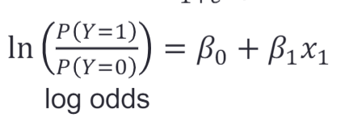
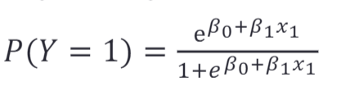
Modeling
Logistic regression
Regression technique used when the target variable is categorical. Instead of trying to predict Y as a continuous variable, it is P(Y=1) which is predicted. P(Y=1) is modeled using a logistic regression function that gives outputs between 0 and 1 The logistic regression function is used to squash the output to [0,1] Function :
With and

Slide 27
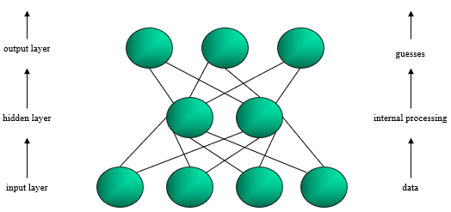
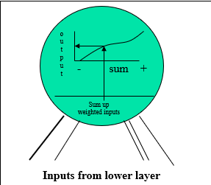
Modeling
Artificial Neural Networks
Simulate the brain’s cognitive learning process
Search for complex relationships
Predict, compare and adjust – correct the model’s mistakes over and over again (Back Propagation via Gradient Descent method)
System of nodes and weighted connections : input layer nodes receive the data and output layer nodes produce the response of the neural network.
Integration function of nodes calculates weighted sum of all inputs
Activation function converting weighted sum into an output value. Most common activation function is Sigmoid function :

Slide 28
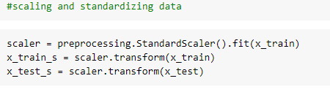
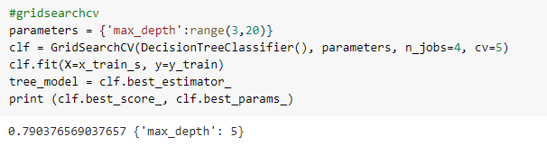
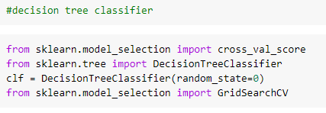
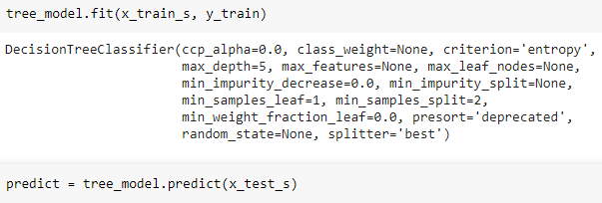
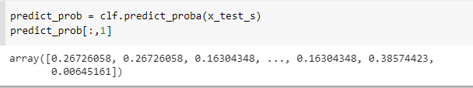
Modeling
Defining model variables :
Splitting the dataset:
Scaling and standarzing the data :
C4.5 implementation :

Slide 29
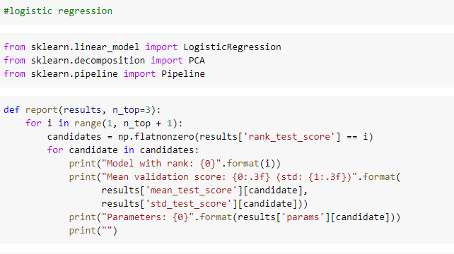
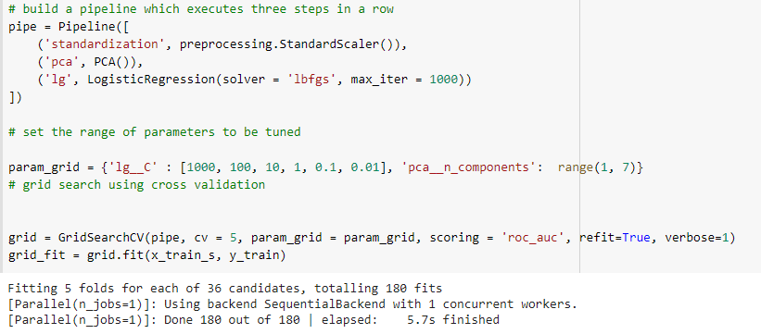
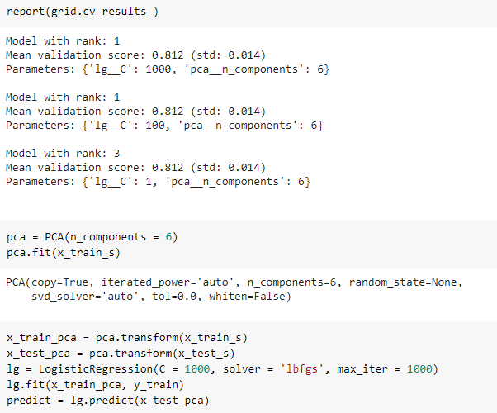
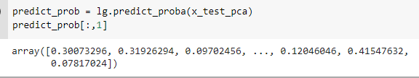
Modeling
Logistic regression implementation
Building of pipeline to determine the best parameters for Logistic regression algorithm using Principal Component Analysis (PCA) as well, via Grid search cross validation.
Optimal PCA fitted on training data and then optimal Linear Regression fitted to PCA fitted training set. At last, prediction made on test set via trained algorithm.

Slide 30
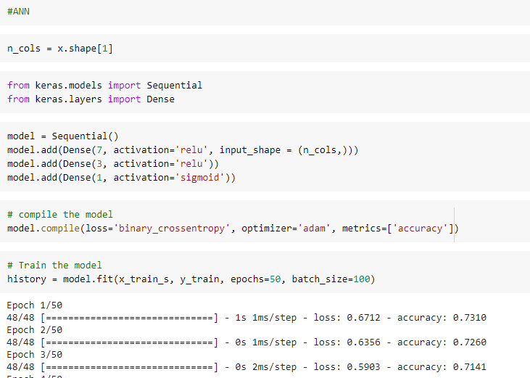
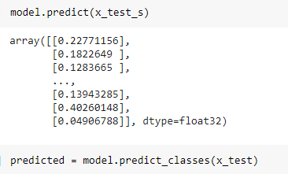
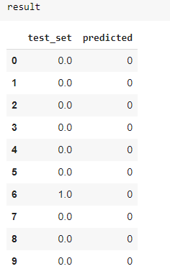
Modeling ANN implementation
All necessary packages imported and run.
The picture on the lower hand left side shows a comparison between the first 9 data points in the test set and the equivalently predicted data points.

Slide 31
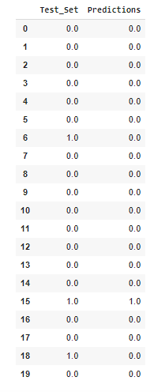
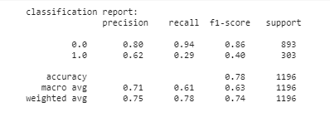



Evaluation
C4.5 decision tree
The model AUC is 0.79
On the left are the predictions compared to actual values in test set (1 for churn and 0 otherwise)
The confusion matrix:
The classifier reached an accuracy of 0.78

Slide 32
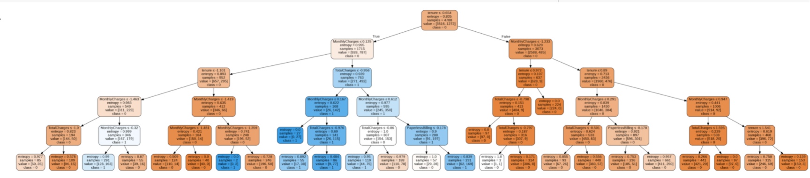
Evaluation
Decision tree graph

Slide 33
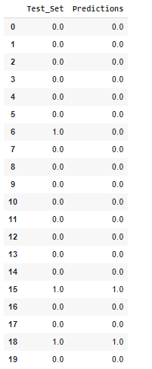
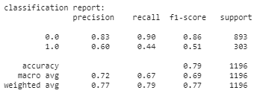

Evaluation
Logistic Regression
The model AUC is 0.81
On the left are the predictions compared to actual values in test set (1 for churn and 0 otherwise)
The confusion matrix:
The classifier reached an accuracy of 0.79

Slide 34
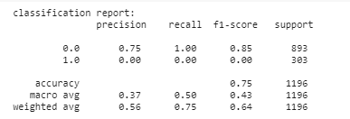
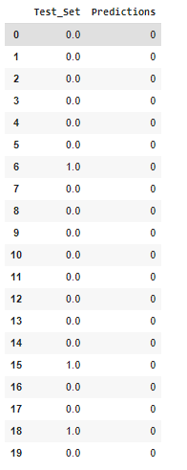


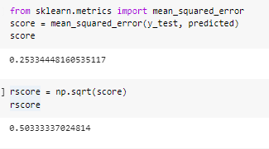
Evaluation
The model AUC is 0.50
ANN
On the left are the predictions compared to actual values in test set (1 for churn and 0 otherwise)
The confusion matrix:
The classifier reached an accuracy of 0.75
The root mean squared error was also computed with a result of 0.51.

Slide 35

Evaluation
By comparing these 3 algorithms, even if the accuracy were very close, the Logistic Regression turned out to be the most accurate for predicting customer churn, with a score of 0.79.
For future work, it might be interesting to apply early stopping to the ANN algorithm to see if it impacts positively its accuracy.

Slide 36
Deployment
Final phase of the CRISP-DM process. The model created and selected will be used and performed for deployment.
In the evaluation phase, the logistic regression was determined as most accurate to predict customer churn (accuracy of 0.79).
At first, the model will be applied to a small set of new data.
Reports of results will be provided and verified to confirm success.
Deliverables will be compared against goal.
To finish, the chosen model execution instructions will be communicated to the concerned departments at the telecommunication company. From that moment on, they could use the model to predict churn.
Regular updates have to be performed with new data to ensure model is still efficient and accurate, and potentially look for another one.

Slide 37
Conclusion
The selected model showed a performance of 0.79 (accuracy) meaning that the prediction success rate is of 79%.
79% of the time, the model predicts correctly which client will churn or not.
Good performance
Only 7 variables were significant in determining churn.
The performance of the model could be optimized with more data, via combination of different algorithms, or by further optimizing other algorithms used in this study and observe their accuracy evolution.

